Slide 1
Attention Deficit Hyperactivity Disorder (ADHD)
Prof. K. A. L. A Kuruppuarachchi MD(Psych), FRCPsych (UK), FSLCOP Senior Professor of Psychiatry – University of Kelaniya

Slide 2

Attention deficit hyperactivity disorder (ADHD) - DSM
Hyperkinetic disorder – ICD

Slide 3
Case history ;
An 8 year old, Namal has had declining school performance over the last two years. He is fidgety , restless and tends to disturb the other students in his class often. Unable to sit still and constantly quarrels with peer students. Would stand up frequently and finds it difficult to pay attention to lessons. Mother said when Namal is taken to a shop he would pull the items haphazardly and run here and there without any control. Mother is very tired as a result of his constant disturbed behavior at home as well…

Slide 4
Epidemiology
Prevalence
ICD criteria & Nice guidelines – 1-2 % in school age children , probably more severe symptoms
Royal College of Psychiatrists (UK) – 2-5% in school age children
World – 5.2-7.1% among children & adolescents
DSM 1V – 3-9%
Usual figure – 5% among school age population
About 2.5% among adults, some studies about 4% among adults

Slide 5
Boys >girls (about 2-3:1 or even higher among boys depending on the study)
Higher rate among parents and siblings
First degree biological relatives are at higher risk of developing ADHD

Slide 6
Clinical features
Inattention eg. often fails to give close attention to details or makes careless errors in schoolwork, work or other activities Often fails to sustain attention in tasks or play activities
(ICD 10 – at least 6 symptoms from 9)
Hyper activity (Unable to stay in the expected period of time),
eg. often fidgets with hands or feet or squirms on seat ( ICD 10 -at least 3 symptoms among 5)
Impulsivity eg. Often fails to wait in lines or await turns in games or group situations.
( ICD 10- at least 1 symptom among 4)

Slide 7
Pervasive nature and persistent pattern
Symptoms are present in more than two settings eg. At school/home ; School/home/clinic
Negatively affect the school/academic/occupational activities
Symptoms/behavioural patterns are inconsistent with the developmental level.
Not due to other disorders like mood disorders, psychotic disorders, autism and substance abuse
Duration - More than 6 months
Onset before 7 years of age (ICD)
Before 12 years of age (DSM 5)
Severity : Mild, Moderate, Severe

Slide 8
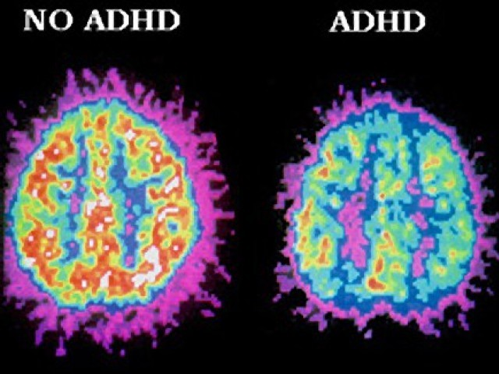
Aetiology
Multifactorial
Genetic factors – significant/strong heritability contribution
Developmental factors – Association of low birth weight, pre-term birth
Environmental factors- Exposure to lead , other toxic chemicals to the brain, parental smoking etc.
Food additives/artificial colourings/certain food items may exacerbate the symptoms.
Neurochemical basis – Neurotransmitter involvement. Dopamine and adrenergic systems.
Neuroanatomical basis – decreased volume and decreased activity in various regions of the brain
Impaired functional connectivity between various brain regions

Slide 9
Presentation
Presents with classic symptoms, poor attention, over activity, impulsivity
Educational underachievement
Other behavioural problems at school such as disturbing the other children

Slide 10

Subtypes
Predominantly inattentive
Predominantly overactive
Combined type

Slide 11
Co-Morbidities
Tic disorders, Anxiety disorders, Mood disorders, Substance Misuse, Conduct disorders, Oppositional defiant disorder, Learning disorders, Speech and Language disorders(Autistic spectrum disorder)

Slide 12
Diagnostic evaluation
Clinical diagnosis
Assessment
Liaison with the school
ADHD Rating Scales
Information needs to be obtained from multiple sources
Physical examination and investigations eg. Thyroid profile, ECG(prior to commencing on medication and periodically), Cardiac status, Blood pressure etc

Slide 13
Differential diagnoses
Oppositional defiant and conduct disorder, learning disorder, mood disorders, anxiety disorders, substance abuse.
Problems with epilepsy – when absence seizures and , frequent seizures at night or antiepileptic medication causing attention problems. Needs to be careful when choosing the ADHD medication.

Slide 14
Management
Pharmacological
Psychostimulants
Methylphenidate
Amphetamine derivatives – dexamphetamine
Common side effects of stimulants - poor sleep, loss of appetite, weight loss, headaches etc

Slide 15
Non stimulants
Atomoxetine
Alpha Agonists
Clonidine
Guanfacine
Antipsychotics eg. Risperidone
Antidepresants eg. Imipramine
Other drugs (may have benefit)
Bupropion
Modafinil

Slide 16
2) Behavioural approaches
Attention training - Communication with the school, keeping the child in the front row close to the teacher, Use of building blocks, attention improving games etc.
Behavioural interventions, classroom interventions
Parental training/psychoeducation
Organizational training for adolescents

Slide 17
3) Remedial education
4) Social skill training
5)Cognitive behavioural therapy for adults
6) Involving the family
7) Counselling of parents

Slide 18
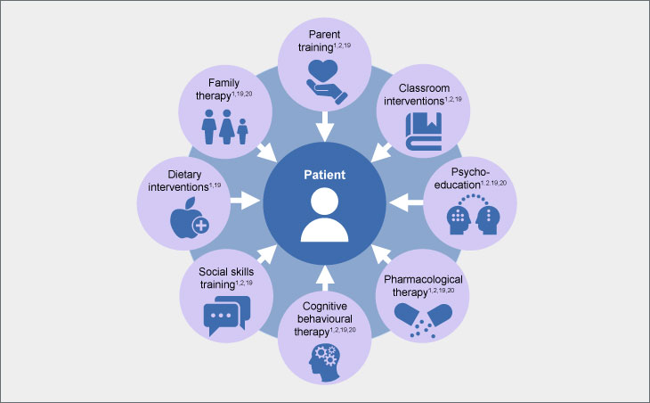
Multimodal approach/treatment

Slide 19

Prognosis
Symptoms may persist to adolescents in 60-85% of cases
Upto 60% in adult life
40% may remit at puberty
Overactivity is the first symptom to remit

Slide 20
Some long term consequences
Problems with psychosocial development- low self esteem, poor relationships
Conduct and emotional disorders, personality disorders in adulthood
eg. anti-social personality disorder, mood disorders
Substance abuse
Impulsive and accident prone
Educational underachievement
Problems with the employment
Important tod etect early and manage properly to minimize the long term problems

Slide 21
THANK YOU!

